Slide 1


INTRODUCTION TO ADVANCED CONCEPTS IN C++
A Quest Global Company

Slide 2
List of Topics to be covered
1. Sequence Containers
1.1 Vector
1.2 Deque
1.3 List
1.4 Forward_list
2. Container Adapters
2.1 Stack
2.2 Queue
2.3 Priority Queue

Slide 3
1. Sequence Containers
Sequence containers store and organize a collection of elements in a sequential manner. They provide direct control over the order of the elements and allow for dynamic resizing and efficient insertion/removal based on the type of container.
What is a sequence container ?
A sequence container in C++ is a type of container from the Standard Template Library (STL) that stores a collection of elements in a specific order.
These containers are designed to organize and manage elements sequentially, meaning the order in which elements are inserted is preserved.
Here's why they are important:
Sequence containers in C++ are essential for managing and organizing data when the order of elements matters.
Their flexibility, efficiency, and ease of use make them indispensable in many applications, particularly where dynamic data manipulation is required.

Slide 4
1. Sequence Containers
Key Characteristics of Sequence Containers
Ordered Storage: Elements are stored and accessed in the order they were added.
Dynamic Sizing: Most sequence containers can dynamically grow or shrink to accommodate more or fewer elements.
Iterators: Provide iterators for traversing and manipulating elements efficiently.
Varied Access Patterns: Each type of sequence container offers specific strengths for accessing and modifying data (e.g., random access, sequential access).
List of Sequence Containers
Vector (std::vector)
Deque (std::deque)
List (std::list)
Forward (std::forward_list)

Slide 5
1.1 Vector
Definition: std::vector is a sequence container in C++ that encapsulates dynamic arrays. It provides the flexibility to store a variable number of elements and automatically manages memory. Key Characteristics:
Dynamic size (grows and shrinks as needed).
Provides random access to elements using indices.
Elements are stored in contiguous memory locations.
Ideal Use Case:
When you need a container that behaves like an array but with the added flexibility of dynamic resizing.

Slide 6
1.1 Vector
Below are operations performed on vectors:
Operation | Description | Example
Element Access
operator[] | Access an element by index (no bounds checking). | vec[2] // Access the 3rd element. | vec[2] // Access the 3rd element.
at() | Access an element by index with bounds checking. Throws std::out_of_range if invalid. | vec.at(2) // Access the 3rd element (with bounds checking). | vec.at(2) // Access the 3rd element (with bounds checking).
front() | Access the first element. | vec.front() // Accesses the first element. | vec.front() // Accesses the first element.
back() | Access the last element. | vec.back() // Accesses the last element. | vec.back() // Accesses the last element.
Modifying the Container
push_back() | Adds an element to the end of the vector. | vec.push_back(5) // Adds 5 to the end of the vector. | vec.push_back(5) // Adds 5 to the end of the vector.
pop_back() | Removes the last element of the vector. | vec.pop_back() // Removes the last element. | vec.pop_back() // Removes the last element.
insert() | Inserts an element at a specified position. | vec.insert(vec.begin() + 2, 99) // Inserts 99 at the 3rd position. | vec.insert(vec.begin() + 2, 99) // Inserts 99 at the 3rd position.

Slide 7
1.1 Vector
Operation | Description | Example
Removing Elements
erase() | Removes one or more elements from a specified position or range. | vec.erase(vec.begin() + 2) // Removes the 3rd element.
clear() | Removes all elements from the vector. | vec.clear() // Removes all elements.
Capacity and Size
size() | Returns the number of elements in the vector. | vec.size() // Returns the size of the vector.
empty() | Returns true if the vector is empty, otherwise false. | vec.empty() // Returns false if vec contains elements.
reserve() | Requests the allocation of enough memory to store n elements. | vec.reserve(100) // Ensures capacity for 100 elements.
capacity() | Returns the allocated capacity (the number of elements the vector can hold without reallocating). | vec.capacity() // Returns the current capacity of the vector.
shrink_to_fit() | Requests reduction of the capacity to fit the size of the vector. | vec.shrink_to_fit() // Reduces capacity to match the size, but not guaranteed to free memory.

Slide 8
1.1 Vector
Operation | Description | Example
Resizing the Vector
resize() | Changes the size of the vector. New elements are initialized with a default value if expanded. | vec.resize(6, 99) // Resizes vector to 6, filling new elements with 99.
Iterators
begin() | Returns an iterator to the first element. | vec.begin() // Iterator to the first element.
end() | Returns an iterator to one past the last element. | vec.end() // Iterator to one past the last element.
rbegin() | Returns a reverse iterator to the last element. | vec.rbegin() // Reverse iterator to the last element.
rend() | Returns a reverse iterator to one before the first element. | vec.rend() // Reverse iterator to one before the first element.

Slide 9
1.1 Vector
Operation | Description | Example
Other Useful Methods
swap() | Swaps the contents of two vectors. | vec.swap(vec2) // Swaps the contents of vec and vec2.
assign() | Replaces the contents with a specified number of elements or a range. | vec.assign(3, 10) // Replaces the contents with three 10s, vec = {10, 10, 10}.
Special Operations
emplace_back() | Constructs an element in place at the end of the vector (avoids copy/move). | vec.emplace_back(10) // Adds 10 to the end without creating a temporary object.
emplace() | Constructs an element in place at a specified position. | vec.emplace(vec.begin() + 2, 100) // Inserts 100 at the 3rd position using in-place construction.

Slide 10
1.1 Vector
Advantages:
Dynamic Sizing:
Automatically grows or shrinks as needed, removing the need for manual memory management.
Contiguous Memory:
Elements are stored in contiguous memory, enabling efficient access and compatibility with low-level operations such as passing to C-style functions.
Fast Random Access:
Supports O(1) time complexity for accessing elements by index, similar to arrays.
Automatic Memory Management:
Handles memory allocation, deallocation, and resizing automatically, reducing the risk of memory leaks.
Type Safety:
Ensures that all elements are of the same type, reducing runtime errors and improving reliability.
When to Use std::vector
Ideal For:
Random access requirements.
Frequent additions/removals at the end of the container.
Scenarios needing contiguous storage for compatibility with legacy C-style arrays or low-level APIs.
Avoid For:
Scenarios with frequent insertions or deletions in the middle or front.
When memory reallocation overhead must be minimized.

Slide 11
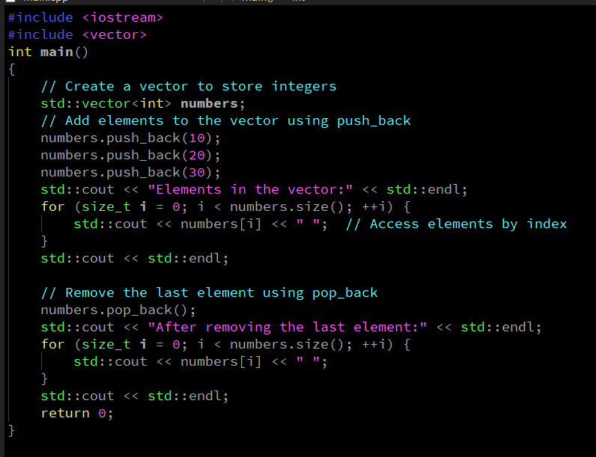
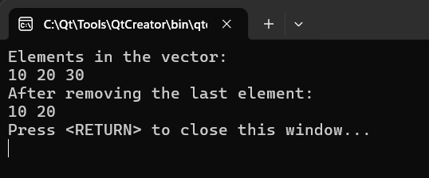
1.1 Vector
Example:-
Output:-

Slide 12
1.2 Deque
Deque (std::deque)
A deque (double-ended queue) in C++ is a dynamic sequence container that allows efficient addition and removal of elements at both ends. Unlike std::vector, it does not store elements in contiguous memory but organizes them in chunks or blocks, which makes it highly versatile for double-ended operations.
Why Use Deques?
Efficient Double-Ended Operations:
Deques allow O(1) insertion and deletion at both the front and back of the container, unlike std::vector, which is inefficient for insertions at the front.
Dynamic Sizing:
Similar to std::vector, deques grow and shrink dynamically, eliminating the need for manual memory management.
Flexibility:
Deques are more efficient than std::vector when frequent insertions and deletions occur at both ends.

Slide 13
1.2 Deque
Below are operations performed on deque:
Element Access
Operation | Description | Example
operator[] | Access an element by index. No bounds checking. | myDeque[2] // Access the 3rd element.
at() | Access an element by index with bounds checking. | myDeque.at(2) // Access the 3rd element safely.
front() | Access the first element. | myDeque.front() // Accesses the first element.
back() | Access the last element. | myDeque.back() // Accesses the last element.
Capacity and Size
Operation | Description | Example
size() | Returns the number of elements. | myDeque.size() // Returns the number of elements in the deque.
empty() | Checks if the deque is empty. | myDeque.empty() // Returns true if deque is empty.
resize() | Changes the number of elements. | myDeque.resize(6, 42) // Resizes to 6, filling new elements with 42.

Slide 14
1.2 Deque
Iterators
Operation | Description | Example
begin() | Returns an iterator to the first element. | auto it = myDeque.begin(); // Points to the first element.
end() | Returns an iterator past the last element. | auto it = myDeque.end(); // Points past the last element.
rbegin() | Returns a reverse iterator to the last. | auto rit = myDeque.rbegin(); // Reverse iterator to the last element.
rend() | Returns a reverse iterator past the first. | auto rit = myDeque.rend(); // Reverse iterator past the first element.

Slide 15
1.2 Deque
Modifying the Container
Operation | Description | Example
push_back() | Adds an element to the end. | myDeque.push_back(5) // Adds 5 to the back.
push_front() | Adds an element to the front. | myDeque.push_front(10) // Adds 10 to the front.
pop_back() | Removes the last element. | myDeque.pop_back() // Removes the last element.
pop_front() | Removes the first element. | myDeque.pop_front() // Removes the first element.
insert() | Inserts an element or range at a position. | myDeque.insert(myDeque.begin() + 1, 99) // Inserts 99 at the 2nd position.
erase() | Removes an element or range of elements. | myDeque.erase(myDeque.begin() + 1) // Removes the 2nd element.
clear() | Removes all elements. | myDeque.clear() // Clears all elements.

Slide 16
1.2 Deque
Below are the scenarios we can prefer deque:
Ideal For:
Scenarios requiring frequent insertions and deletions at both the front and back.
Use cases where random access is occasionally needed but not as frequent as with std::vector.
Implementing queues, double-ended queues, or rolling buffers.
Avoid For:
Scenarios requiring high-performance random access or compatibility with C-style arrays.
When insertions and deletions are concentrated in the middle of the container.

Slide 17
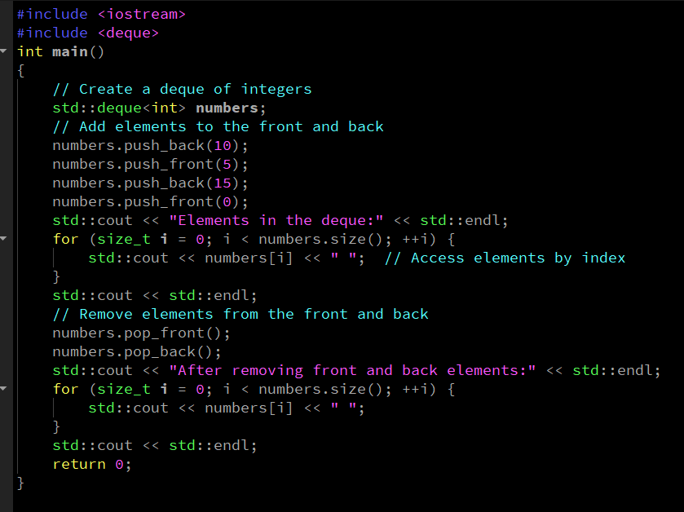
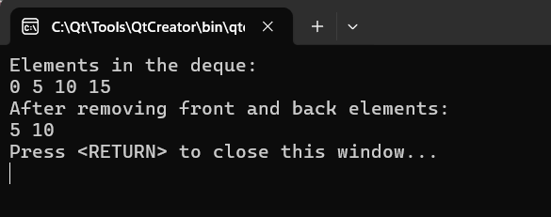
1.2 Deque
Example:-
Output:-

Slide 18
1.3 List
A list in C++ (std::list) is a doubly linked list that allows efficient insertion and deletion at any position. Unlike std::vector or std::deque, it does not store elements in contiguous memory but links them via pointers. This makes std::list ideal for scenarios where frequent insertions and deletions are required, especially in the middle of the container.
Why Use Lists? Efficient Middle Operations:
std::list provides O(1) complexity for inserting or deleting elements at any position when the iterator is known.
No Reallocation Overhead:
Unlike std::vector or std::deque, lists do not require reallocating or moving elements when resized.
Stable Iterators:
Iterators remain valid even after modifications (insertion or deletion) to the container, except when pointing to the erased element.
Bidirectional Traversal:
With its doubly linked structure, lists allow traversal in both forward and backward directions.

Slide 19
1.3 List
Below are operations performed on list:
Element Access
Operation | Description | Example
front() | Access the first element. | myList.front() // Access the first element.
back() | Access the last element. | myList.back() // Access the last element.
Capacity and Size
Operation | Description | Example
size() | Returns the number of elements. | myList.size() // Returns the number of elements.
empty() | Checks if the list is empty. | myList.empty() // Returns true if the list is empty.
Iterators
Operation | Description | Example
begin() | Returns an iterator to the first element. | auto it = myList.begin(); // Iterator to the first element.
end() | Returns an iterator past the last element. | auto it = myList.end(); // Iterator past the last element.
rbegin() | Returns a reverse iterator to the last. | auto rit = myList.rbegin(); // Reverse iterator to the last element.
rend() | Returns a reverse iterator past the first. | auto rit = myList.rend(); // Reverse iterator past the first element.

Slide 20
1.3 List
Modifying the Container
Operation | Description | Example
push_back() | Adds an element to the end. | myList.push_back(5) // Adds 5 to the end.
push_front() | Adds an element to the front. | myList.push_front(10) // Adds 10 to the front.
pop_back() | Removes the last element. | myList.pop_back() // Removes the last element.
pop_front() | Removes the first element. | myList.pop_front() // Removes the first element.
insert() | Inserts elements at a specified position. | myList.insert(it, 20) // Inserts 20 at the iterator it position.
erase() | Removes elements from a specified position. | myList.erase(it) // Erases the element at iterator it.
clear() | Removes all elements. | myList.clear() // Clears all elements in the list.
resize() | Changes the number of elements. | myList.resize(5, 42) // Resizes to 5, filling new elements with 42.
emplace() | Constructs and inserts element at position. | myList.emplace(it, 100) // Inserts 100 at the iterator it.
emplace_back() | Constructs and adds an element at the end. | myList.emplace_back(50) // Appends 50 directly.
emplace_front() | Constructs and adds an element at the front. | myList.emplace_fron

Slide 21
1.3 List
Advantages:-
Efficient Insertions/Deletions: O(1) insertion and deletion anywhere in the container when using iterators.
Stable Iterators: Modifications to the list (insertion/deletion) do not invalidate iterators, except the erased element.
Dynamic Size: Automatically adjusts size as elements are added or removed.
Bidirectional Traversal: Supports efficient forward and backward traversal.
No Reallocation: Since elements are not stored contiguously, there’s no need for reallocating memory during growth.
Disadvantages:-
No Random Access: Does not support direct access to elements by index (e.g., operator[] or at()).
Higher Memory Overhead: Each element stores additional pointers (next and previous), leading to higher memory usage compared to std::vector.
Slower Traversal: Traversing the list is slower compared to std::vector or std::deque due to non-contiguous memory storage.
Inefficient with STL Algorithms: Algorithms like std::sort require copying the list into another container as they cannot utilize random access iterators.

Slide 22
1.3 List
Below are the scenarios we can prefer list:
Ideal For:
Scenarios with frequent insertions and deletions at arbitrary positions.
Cases where iterator stability is important.
Implementing data structures like doubly linked lists, queues, or stacks.
Avoid For:
Situations requiring random access to elements.
Applications where memory usage is a critical concern.
Performance-critical scenarios where the overhead of non-contiguous storage is significant.

Slide 23
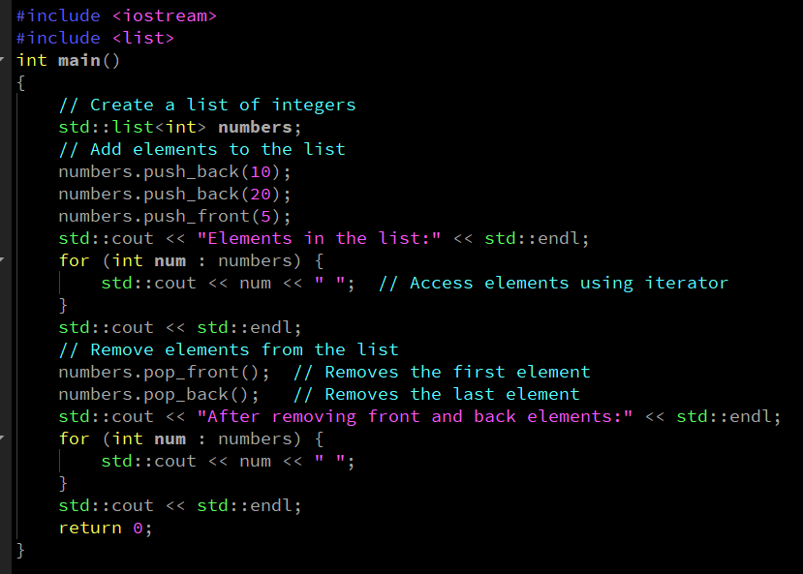
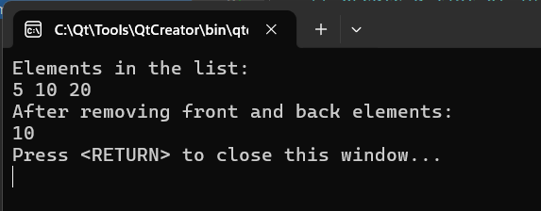
1.3 List
Example:-
Output:-

Slide 24
1.4 Forward List
A forward list in C++ (std::forward_list) is a single-linked list that supports efficient insertion and deletion at any position. Unlike std::list (doubly-linked list), it uses only a single pointer per node, making it more memory-efficient. However, it only supports forward traversal. Why Use std::forward_list? Memory Efficiency:
Requires less memory than std::list as each node stores only one pointer (to the next node).
Efficient Insertions/Deletions:
Provides O(1) complexity for inserting or deleting elements when the iterator is already at the desired position.
Dynamic Growth:
Like other dynamic containers, it automatically grows or shrinks as needed.
Lightweight Container:
Optimized for scenarios where only forward traversal is required, avoiding the overhead of double pointers.

Slide 25
1.4 Forward List
Below are operations performed on forward_list:
Element Access
Operation | Description | Example
front() | Access the first element. | myList.front() // Access first element.
Capacity and Size
Operation | Description | Example
empty() | Checks if the list is empty. | myList.empty() // Returns true if empty.
Iterators
Operation | Description | Example
begin() | Returns an iterator to the first element. | auto it = myList.begin(); // Iterator to the first element.
end() | Returns an iterator past the last element. | auto it = myList.end(); // Iterator past the last element.
cbegin() | Returns a constant iterator to the first element. | auto it = myList.cbegin(); // Const iterator to the first element.
cend() | Returns a constant iterator past the last element. | auto it = myList.cend(); // Const iterator past the last element.

Slide 26
1.4 Forward List
Modifying the Container
Operation | Description | Example
push_front() | Adds an element to the front. | myList.push_front(10) // Adds 10 to the front.
pop_front() | Removes the first element. | myList.pop_front() // Removes the first element.
insert_after() | Inserts elements after a specified position. | myList.insert_after(it, 20) // Inserts 20 after iterator it.
erase_after() | Removes elements after a specified position. | myList.erase_after(it) // Removes the element after iterator it.
emplace_front() | Constructs and inserts an element at the front. | myList.emplace_front(5) // Constructs 5 at the front.
emplace_after() | Constructs and inserts elements after a position. | myList.emplace_after(it, 42) // Constructs 42 after iterator it.
clear() | Removes all elements. | myList.clear() // Clears all elements.
resize() | Changes the size of the list. | myList.resize(5, 42) // Resizes to 5, filling new elements with 42.

Slide 27
1.4 Forward List
Advantages:-
Memory Efficiency: Only requires one pointer per node, making it more space-efficient than std::list.
Efficient Insertions/Deletions: O(1) insertion and deletion when the iterator is positioned correctly.
Dynamic Growth: Automatically adjusts size based on the number of elements.
Reduced Overhead: Lightweight alternative to std::list when backward traversal is not needed.
Stable Iterators: Iterators remain valid after modifications, except for the removed elements.
Disadvantages:-
No Random Access: Does not support direct access to elements by index.
Only Forward Traversal: Cannot traverse backward, unlike std::list.
Slower Iteration: Traversing to a specific position requires O(n) time, as only forward traversal is allowed.
Limited STL Algorithm Compatibility: Lacks random access iterators, which are required by many STL algorithms.

Slide 28
1.4 Forward List
Below are the scenarios we can prefer forward_list:
Ideal For:
Scenarios where memory usage is critical.
Applications requiring frequent insertions and deletions, especially at the front or after specific positions.
Situations where only forward traversal of elements is needed.
Avoid For:
Applications requiring backward traversal or random access.
Scenarios with frequent middle operations when backward traversal might be beneficial.
Cases where STL algorithms requiring random access are needed.

Slide 29
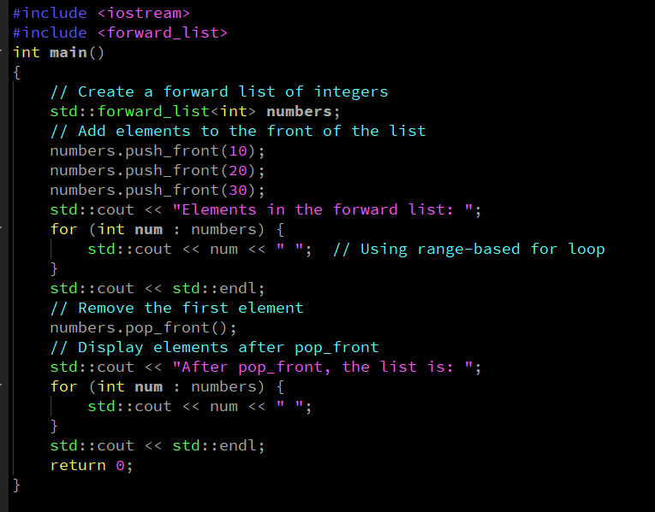
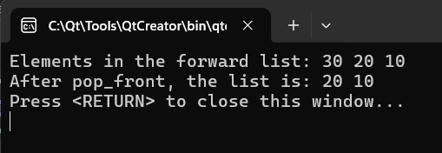
1.4 Forward List
Example:-
Output:-

Slide 30
2. Container Adapters
Container Adapters are specialized containers in C++ that provide a simplified and specific interface over existing containers like std::vector, std::deque, or std::list. They act as "wrappers" to adapt the underlying containers to serve a particular purpose.
The Standard Template Library (STL) includes three container adapters:
Stack (std::stack)
Queue (std::queue)
Priority Queue (std::priority_queue

Slide 31
2.1 Stack
A stack is a container adapter in C++ that implements the Last In, First Out (LIFO) principle. Elements are added and removed from the same end, known as the "top" of the stack. The std::stack is designed for scenarios where you need restricted access to the container: only the most recently added element can be accessed or removed.
Why Use std::stack?
LIFO Data Management:
Ideal for tasks that require processing elements in reverse order of their arrival.
Simplified Interface:
Focused on basic stack operations: push, pop, and top, providing an easy-to-use abstraction.
Underlying Container Flexibility:
Allows selection of an underlying container (std::deque, std::vector, or std::list) to meet specific performance needs.
Common Applications:
Parsing and evaluating expressions.
Implementing function call stacks in compilers.
Backtracking algorithms like Depth-First Search (DFS).

Slide 32
2.1 Stack
Below are operations performed on stack:
Operation | Description | Example
push() | Adds an element to the top of the stack. | myStack.push(10); // Adds 10 to the top.
pop() | Removes the top element of the stack. | myStack.pop(); // Removes the top element.
top() | Accesses the top element without removing it. | int t = myStack.top(); // Retrieves the top element.
empty() | Checks if the stack is empty. | if (myStack.empty()) { ... } // True if the stack is empty.
size() | Returns the number of elements in the stack. | size_t n = myStack.size(); // Number of elements in the stack.

Slide 33
2.1 Stack
Advantages:-
Simplicity: Minimal operations ensure ease of use and clarity in implementing LIFO logic.
Flexibility in Implementation: Can use std::deque (default), std::vector, or std::list as the underlying container:
std::deque: Best for general-purpose stack operations.
std::vector: Suitable when frequent resizing is unnecessary.
std::list: Ideal for efficient middle operations, though rarely needed for a stack.
Memory Efficiency: Depending on the underlying container, memory can be managed effectively.
Performance: Stack operations (push, pop, and top) are O(1).
Disadvantages
Restricted Access:
No direct access to elements other than the top.
Lack of iterators prevents traversal of elements.
Limited Customization:
The stack's interface is strictly limited to LIFO operations.
Not Suitable for Sequential Access:
If you need random or sequential access to elements, other containers like std::vector are better suited.

Slide 34
2.1 Stack
Below are the scenarios we can prefer stack:
Scenario | Description
Expression Parsing | Evaluate postfix, prefix, or infix expressions using a stack for operands/operators.
Function Call Management | Implement function call stacks or recursive function handling.
Backtracking Algorithms | Use stacks for algorithms like Depth-First Search (DFS).
Undo/Redo Functionality | Maintain a history of actions for undo/redo operations.
Parenthesis Matching | Check for balanced parentheses in expressions.
Temporary Data Storage | Store data temporarily for reverse processing.

Slide 35
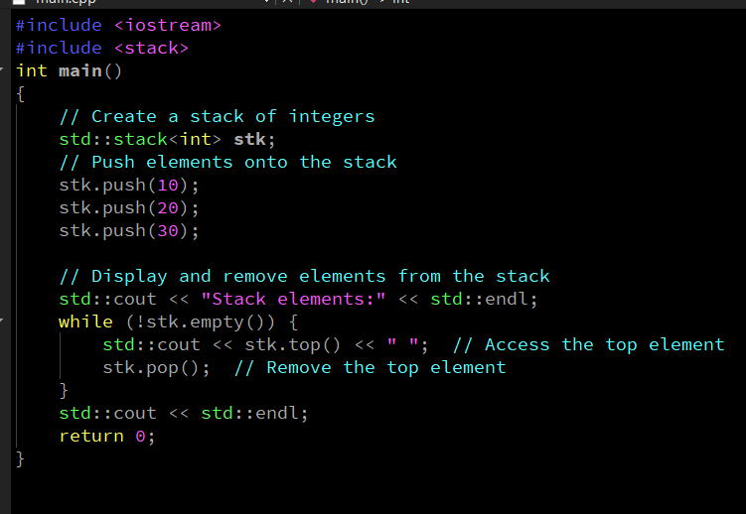
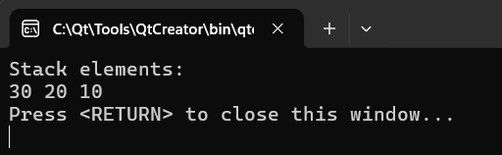
2.1 Stack
Example:-
Output:-

Slide 36
2.2 Queue
A queue is a container adapter in C++ that implements the First In, First Out (FIFO) principle. Elements are inserted at the back and removed from the front. The std::queue provides a simple interface for managing FIFO data structures, making it suitable for applications where sequential processing is required.
Why Use std::queue?
FIFO Data Management:
Useful for scenarios where elements are processed in the order they arrive.
Simplified Interface:
Provides focused operations: push, pop, front, and back.
Underlying Container Flexibility:
Supports multiple underlying containers (std::deque by default, and std::list as an alternative) for tailored performance.
Common Applications:
Task scheduling.
Breadth-First Search (BFS) in graphs.
Event handling systems and buffers.

Slide 37
2.2 Queue
Below are operations performed on queue:
Operation | Description | Example
push() | Adds an element to the back of the queue. | myQueue.push(10); // Adds 10 to the back.
pop() | Removes the front element of the queue. | myQueue.pop(); // Removes the front element.
front() | Accesses the front element without removing it. | int f = myQueue.front(); // Retrieves the front element.
back() | Accesses the back element without removing it. | int b = myQueue.back(); // Retrieves the back element.
empty() | Checks if the queue is empty. | if (myQueue.empty()) { ... } // True if the queue is empty.
size() | Returns the number of elements in the queue. | size_t n = myQueue.size(); // Number of elements in the queue.

Slide 38
2.2 Queue
Advantages:- FIFO Order Maintenance: Automatically maintains the order of elements for sequential processing.
Simplicity: Restricts operations to only those relevant for a queue, ensuring ease of use.
Flexibility in Implementation: Can use std::deque (default) or std::list as the underlying container:
std::deque: Ideal for general-purpose queue operations.
std::list: Useful for scenarios requiring frequent middle insertions or deletions (though rarely necessary in queues).
Efficient Element Management: Push and pop operations are O(1) with std::deque.
Memory Efficiency: Underlying container options allow memory management optimization.
Disadvantages:-
Restricted Access: No direct or random access to elements other than the front or back.
Limited Customization:The queue's interface is fixed to FIFO operations.
Traversal Not Supported: No iterators to traverse the elements.

Slide 39
2.2 Queue
Below are the scenarios we can prefer queue:
Scenario | Description
Task Scheduling | Manage tasks in the order they are received (e.g., printer job scheduling).
Breadth-First Search (BFS) | Traverse graphs or trees level by level.
Event Handling Systems | Process events sequentially in the order of occurrence.
Data Buffers | Use as a buffer for data streaming applications.
Customer Service Systems | Simulate customer queues in real-world applications.
Pipeline Processing | Pass data between stages in a sequential order.
Underlying Container Comparison
Underlying Container | Advantages
std::deque | Efficient push/pop operations at both ends.
std::list | Useful when frequent middle insertions/deletions are required (rare in queues).

Slide 40
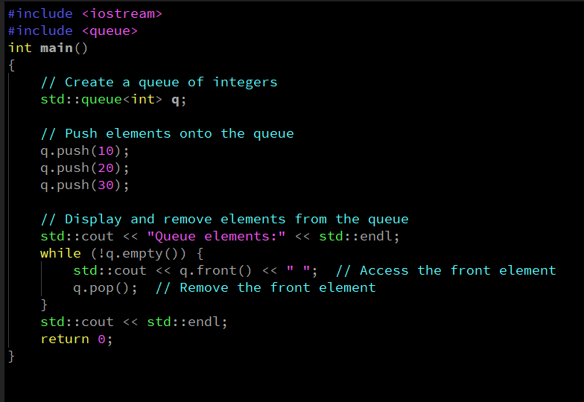
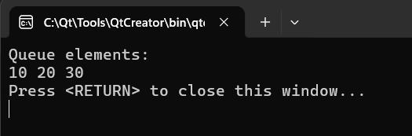
2.2 Queue
Example:-
Output:-

Slide 41
2.3 Priority Queue
A priority queue in C++ is a container adapter that arranges elements based on their priority. Unlike a regular queue, where the order of insertion determines the order of removal, a std::priority_queue always ensures that the element with the highest priority (default: largest value) is at the front and is removed first.
By default, std::priority_queue is implemented as a max-heap, but it can be customized for other priority orders using comparators.
Why Use std::priority_queue?
Efficient Priority Management:
Ensures the element with the highest priority is always accessible in O(1) time.
Dynamic Sorting:
Automatically maintains the heap structure as elements are added or removed.
Customizable Priority:
Custom comparators allow the creation of min-heaps or other specialized orderings.
Common Applications:
Scheduling tasks based on priority.
Implementing algorithms like Dijkstra’s shortest path.
Event simulation systems.

Slide 42
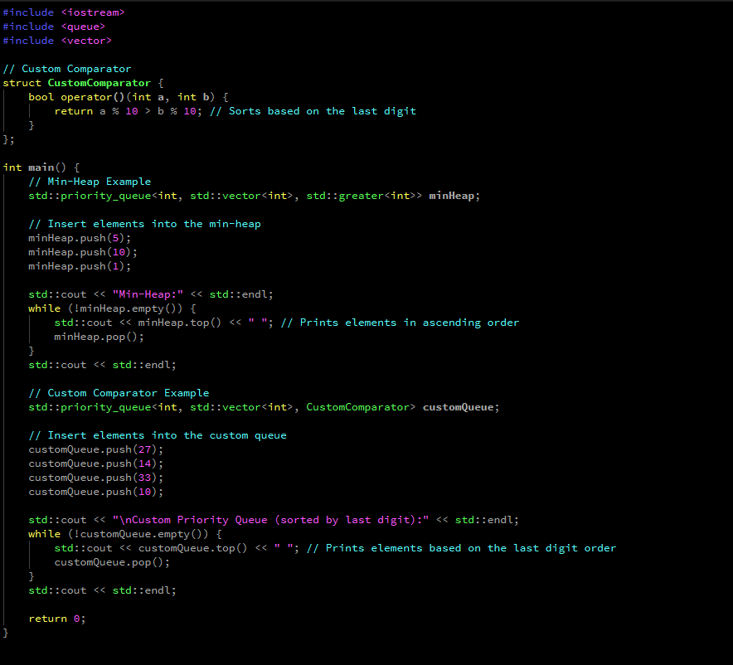
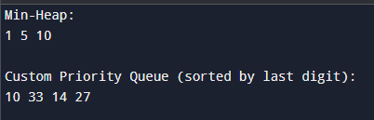
2.3 Priority Queue
The default comparator ensures that std::priority_queue behaves as a max-heap. To create a min-heap or other custom orders, a comparator can be specified:
Example:-
Output:-

Slide 43
2.3 Priority Queue
Advantages of std::priority_queue
Efficient Element Management:Provides O(log n) complexity for push and pop, and O(1) complexity for accessing the highest-priority element.
Dynamic Priority Maintenance: Automatically reorders elements to maintain the heap structure.
Customizability: Custom comparators allow the implementation of specialized priority rules.
Flexibility: Useful for managing prioritized data efficiently without manual sorting.
Memory Efficiency: Uses std::vector as the underlying container, leveraging dynamic memory allocation.
Disadvantages of std:: priority_queue
Restricted Access: No direct access to elements other than the top (highest-priority element).
No Traversal: Lacks iterators for element traversal or inspection.
Limited Use Cases: Primarily useful when priority-based processing is required; not suitable for general-purpose storage.

Slide 44
2.3 Priority Queue
Below are the scenarios we can prefer priority_queue:
Scenario | Description
Task Scheduling | Prioritize tasks based on their importance or urgency.
Dijkstra’s Algorithm | Find the shortest path in a graph using priority-based processing of nodes.
Event Simulation Systems | Handle events based on their scheduled time or priority.
Job Processing | Process jobs or requests in order of priority (e.g., OS scheduling).
Merging Sorted Arrays | Combine multiple sorted arrays efficiently.
Underlying Container:-
The std::priority_queue uses std::vector as the default underlying container, with a heap structure built on top of it. Other containers like std::deque can also be used but are less common.
Note:-The std::priority_queue is a powerful tool for efficiently managing and processing prioritized data. Its automatic sorting and flexible priority customization make it ideal for use cases requiring order and prioritization.

Slide 45


Thank You

